Slide 1
Rain In Australia
Raanan Kelner & Elad Katz
Jul 2021

Slide 2
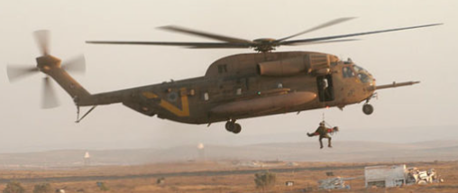
Our Mission
We are helping Australia 669 rescue team allocate forces and prepare to rain emergency occurrence and save lives. We strive to be accurate as possible with 85%.
Our Goals:
Predice rain events all over Australia so that the team will not have to on-duty 24/7 but only on day with high probability for rain related rescue missions
Predice rain events in Australian desert area, where floods are a major source of danger
Predict rain events during summer time, when people are less prepare for
Predict storm events, where it rains more the 2 days or more

Slide 3
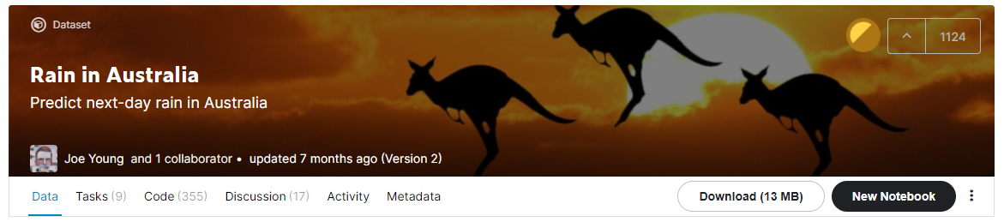
The Data
10 Year of Daily data on weather and climate in different locations in Australia.
The dataset have 23 column of data as humidity, wind speed and direction, air pressure, rain today etc
The data to predict is: will it rain tomorrow
Link: https://www.kaggle.com/jsphyg/weather-dataset-rattle-package

Slide 4
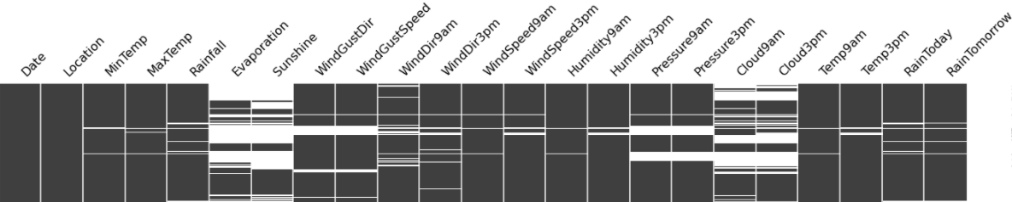
Pre Processing
Missing data - If it was the y, we dropped it. If it was a feature, we used Simple Imputer mean strategy.
Categorical Data - Convert character to numeric using Ordinal Encoder
Data - Split to year, month, week so we can easily address seasonality and summer times
Location - clean location and add GPS point using Geo Pandas, and mark desert areas

Slide 5
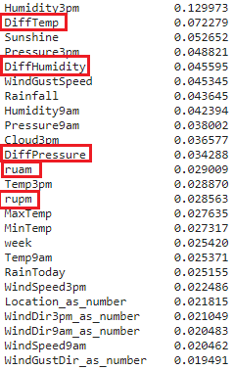
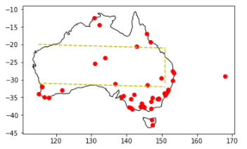
Feature Engineering
Feature engineering importance:
DiffTemp - Measure changes in temperature during the day
DiffHumidity - Measure changes in humidity during the day
Diff Pressure - Measure changes in air pressure during the day
RUAM - air density at 9am Pressure9am / (R 0.16 *(Temp9am + C2K 273.15))
RUPM -air density at 3pm Pressure3pm / (R 0.16*(Temp3pm + C2K 273.15))
is_Desert - area which is considered as desert
We used a 3 sigma method to clean the outliers

Slide 6
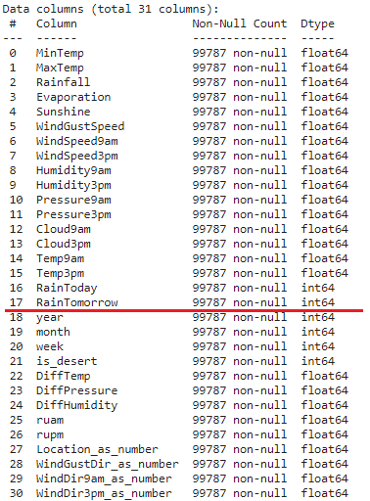
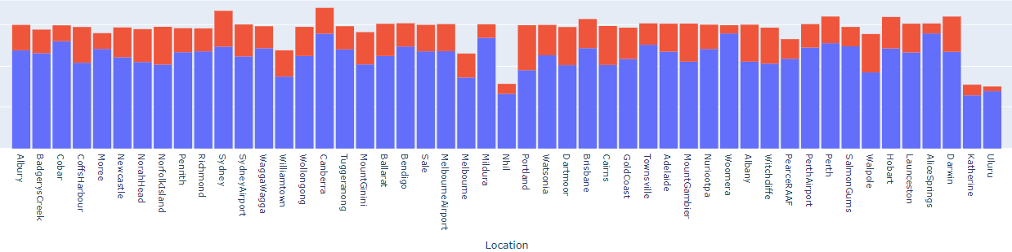
The data used for the predictor
We add 7 Calculated column
We enriched the data with 3 columns
We converted 5 Columns
Unbalance Data - We preferred Precision over Accuracy

Slide 7
The Predictores
Unbalanced | Pred No Rain | Pred Rain
Actual No Rain | 16,710 | 2,748
Actual Rain | 2,478 | 3,011
Decision Tree -Unbalanced Data and Balanced Data. cross validation
AdaBoost of DT - GridSearch
Gradient Boosting of DT
XGBoost of DT
Random Forest of whole data and RF for desert only and RF for summer
Logistic Regression
Balanced | Pred No Rain | Pred Rain
Actual No Rain | 14,671 | 4,787
Actual Rain | 1,173 | 4,316
Balance Model Predict 58% more rain

Slide 8
Predictor Results
XGBoost | Pred No Rain | Pred Rain
Actual No Rain | 23376 | 4,021
Actual Rain | 1737 | 6,063
Decision Tree -Unbalanced Data and Balanced Data. 79% and 81%
AdaBoost / Gradient Boosting of DT - 78% / 79% without any improvement and cost time about 1000% / 4000%
XGBoost of DT - 83% with small improvement and cost time about 2000%
Random Forest of whole data (77%) and RF for desert(91%) only and RF for summer(89%)
Logistic Regression - 84%
Random Forest | Pred No Rain | Pred Rain
Actual No Rain | 26391 | 1,006
Actual Rain | 4016 | 3,784

Slide 9
What helped improve the results
Separating data for desert area and summer time did get us a better result for those areas or times which were important for us.
Encoder was very “handy” to convert the categorical data to int, so our models could work.
Calculation of some feature engineering helped us as we did some reading about Australia weather and climate. Furthermore, reading about how forecasting weather work helped us to find some more relevant data.
We add geographical data to find the desert area and place cities over the map.

Slide 10
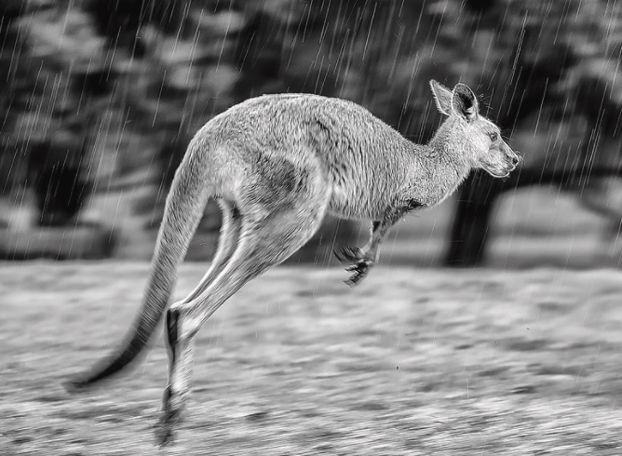
Conclusions
Data Cleaning and feature engineering is important and time consuming
Knowing and using sklearn package saves you a lot of work
GPS Geographic data enrichment with python is a simple but not easy
Learn about Meteorology and Australia climate improve the model
Handle the data balance improved the model
Accuracy and Precision are a trade of
We didn't have enough time the create a model for each city
We think that we overfit the Humidity3pm over location and today.

